Slide 1
LESSON 1
Let’s work together!

Slide 2
BACK INTO THE WORLD
Lesson 1 Let’s work together
Key Vocabulary:
Differences
Things which are not the same
Feelings
How we feel about things
Beliefs
Something that people think is true
Respect
Being nice and caring for someone
Class Rules
How to behave in class and in school
Mental Health
How you look after your brain and feelings
Joanna Marie Skillett & Chloë Chapman © 2021

Slide 3
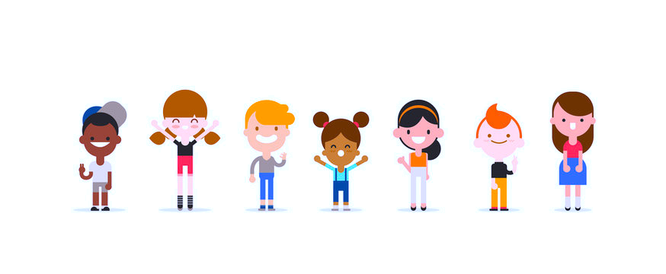
BACK INTO THE WORLD
Lesson 1 Let’s work together
In Back to the World, Lexi, Nexy and Texy are trying to fix their Happy-o-meter.
Sometimes, our own Happy-o-metre can also need some help.
THINK: How did you feel on your first day of School?
happy
excited
worried
tired
shy
ok
scared
THINK: What would you say to help someone on their first day?
Joanna Marie Skillett & Chloë Chapman © 2021

Slide 4
BACK INTO THE WORLD
Lesson 1 Let’s work together
Mental Health: Look after you and everyone!
Sometimes we can feel sad, worried, lost, scared and this is OK.
We can ask for help and talk about it.
If we work together, we can help each other feel happy again…
SAD
OK
HAPPY
Joanna Marie Skillett & Chloë Chapman © 2021

Slide 5
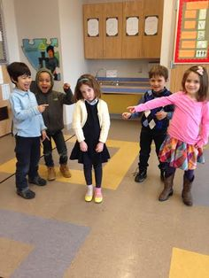
BACK INTO THE WORLD
Lesson 1 Let’s work together
SCENE FREEZE SOLVE!
Joanna Marie Skillett & Chloë Chapman © 2021

Slide 6
BACK INTO THE WORLD
Lesson 1 Let’s work together
Scene - What can you do?
“I am nervous about starting School.”
“I worry that I won’t have anyone to play with at lunchtime.”
“I find Maths class really hard and I am stuck.”
“Children are laughing at my glasses and I feel embarrassed.”
“Someone wasn’t very nice to me and I feel sad.”
“I fell over in the playground and my knee hurts.”
THINK: Can you think of another scene that you could solve?
Joanna Marie Skillett & Chloë Chapman © 2021

Slide 7
BACK INTO THE WORLD
Lesson 1 Let’s work together
Did you solve the scene?
Decide as a class, where is the Class Happy-o-meter now?
SAD
OK
HAPPY
Joanna Marie Skillett & Chloë Chapman © 2021

Slide 8
BACK INTO THE WORLD
Lesson 1 Let’s work together
Let's keep our Class happy and our Mental Health healthy!
THINK:
Can you think of a good Class Mental Health Motto
to help us work together and be happy?
Its ok ☺
We are here to help.
Ask for help to be happy ☺
Joanna Marie Skillett & Chloë Chapman © 2021

Slide 9
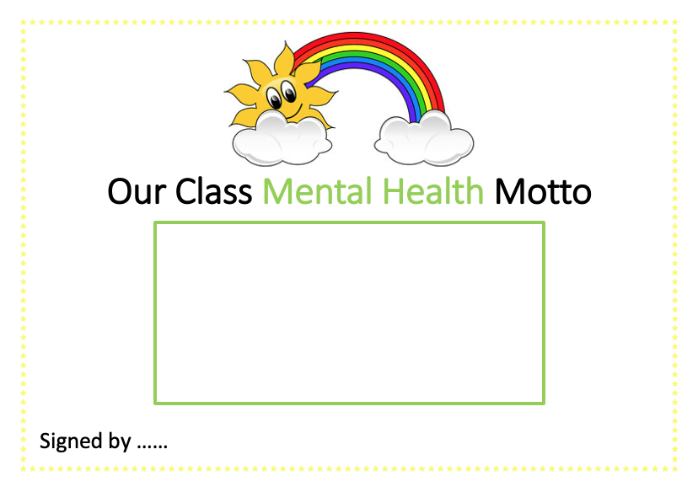
BACK INTO THE WORLD
Lesson 1 Let’s work together
Make a Mental Health class motto
Sign your name!
Put it up in your classroom!
Joanna Marie Skillett & Chloë Chapman © 2021

