Slide 1
Lesson One: Chivalric Tales
The Novel
LO: To understand the history and characteristics of chivalric tales and to use that knowledge to describe the characters of Aidan.

Slide 2
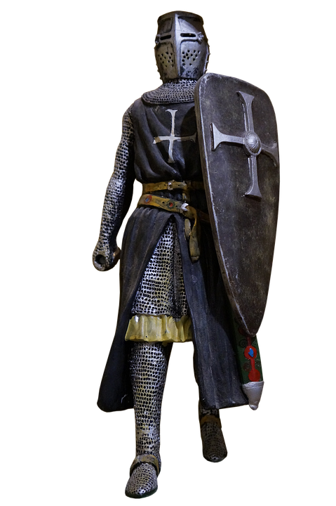
Starter Task
Today we’re going to be talking about knights. Chances are you already know quite a lot about knights, from books, movies and games.
So, what do you already know about knights? Label your knight with what you know.
Hints:
What do knights wear?
What do they do?
What are their characteristics?
Can you name any famous knights?
Prepare for Learning

Slide 3
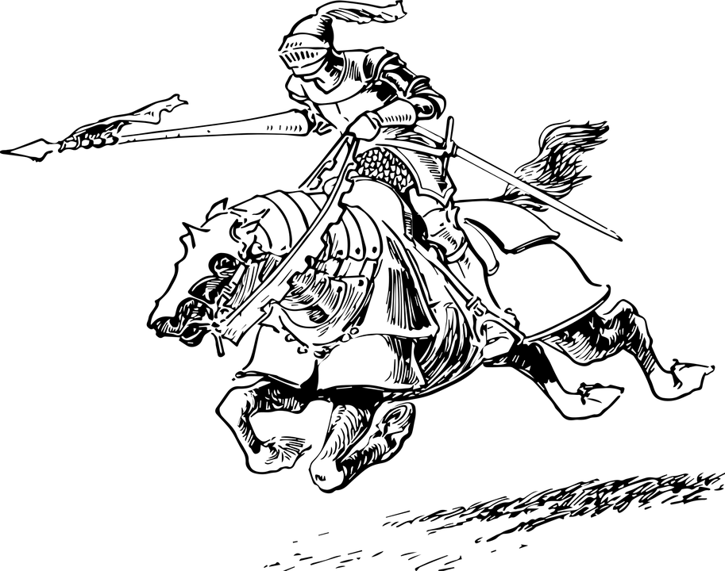
Agenda
Starter Task: Characteristics of a Knight
Agenda: What we’re learning today
New information: Chivalry and literature
Watch: Act One of Aidan
Write: Descriptions of Aidan Characters
Review: Quiz!
Agree Learning Outcomes

Slide 4
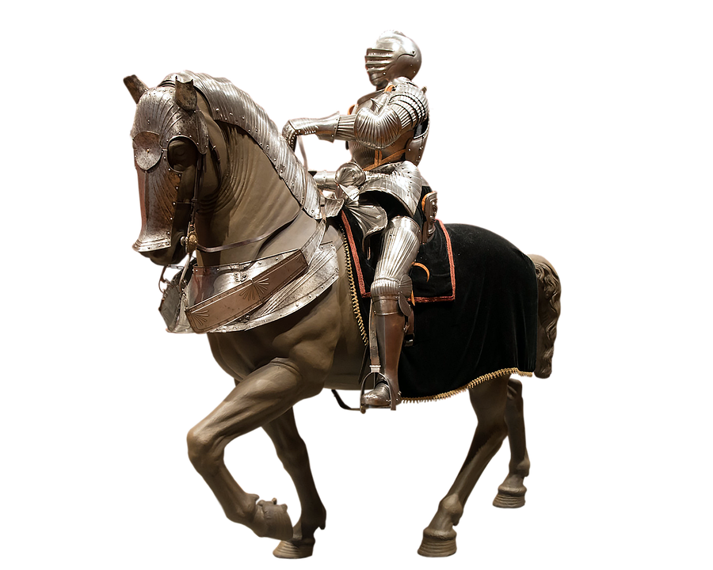
Chivalric Tales
Definition of Chivalry:
1. Mounted men-at-arms; knights
2. The qualities of the ideal knight: chivalrous conduct
A Chivalric Tale is a story about knights, or “men of arms.”
It is a type of story that was popular in the noble courts of Medieval Europe.
Chivalric Tales were fantastic stories about marvel-filled adventures, often of a chivalric knight portrayed as having heroic qualities, who goes on a quest. They come from a genre of stories known as epics.
But they developed away from other types of epic as time went on, mostly because they had an emphasis on love and on courtly manners, or chivalrous conduct.
Unlike other epics, where knights were portrayed as super-masculine soldiers, chivalric tales focused on the human elements; the relationships, the honour and the qualities of the ideal knight.
Present New Information

Slide 5
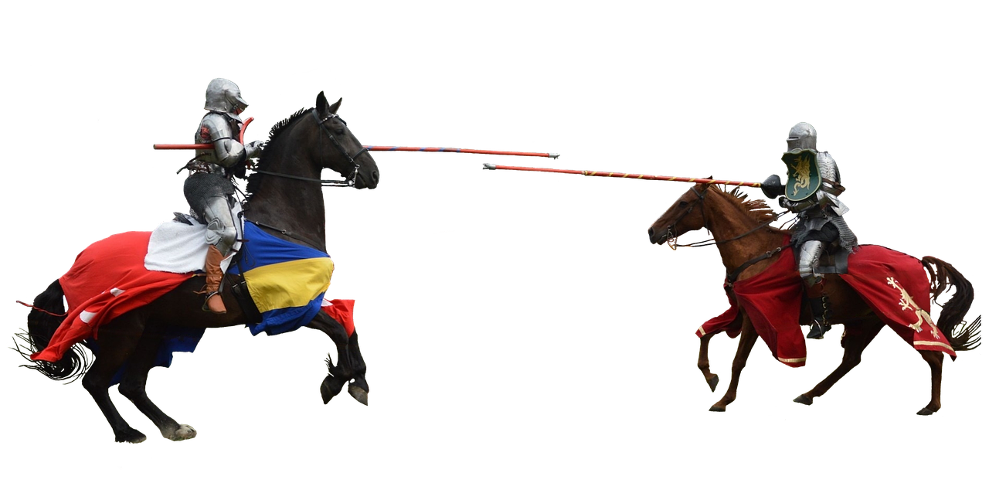
Chivalry
Chivalric Tales recount the marvellous adventures of a chivalrous, heroic knight, often of super-human ability, who, abiding chivalry's strict codes of honor and demeanor, goes on a quest, and fights and defeats monsters and giants, thereby winning favor with a lady.
Chivalry is still a word we use today; it means being a gentleman, being honourable, respectful and courteous to women and everyone you meet.
Women can be chivalrous too; it’s all about the way we, as people, choose to treat others.
Question: Who can think of an example of modern-day chivalry?
Present New Information

Slide 6
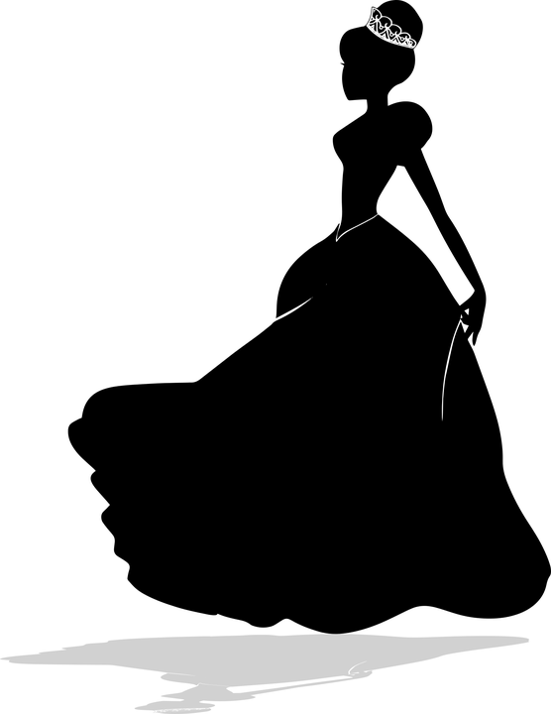
Chivalric Characters
Princess
Prince
Witch
You’ve already labelled your Knight; now have a go at the other characters. What do you know already about Princes, Princesses and Witches? Think of examples you’ve seen in books, films and video games
Present New Information

Slide 7
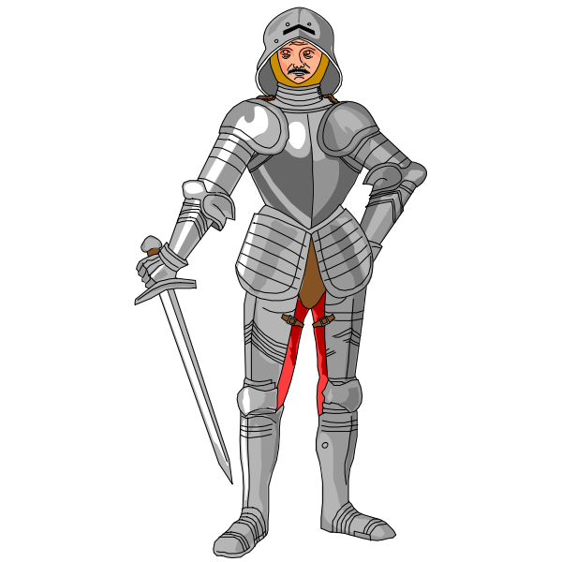
Amadis De Gaul
Amadís de Gaul is a landmark work among Chivalric Tales.
The story tells the star-crossed love of King Perión of Gaul and Elisena of England, resulting in the secret birth of Amadís.
The place called “Gaul” is a made-up kingdom in Brittany. It has been identified with Wales or France, but it is better to think of it as a completely imaginary place.
As a knight, Amadís is courteous, gentle, sensitive, and a Christian, who dares to defend free love.
Unlike most heroes of his time, Amadís is a handsome man who would cry if refused by his lady, but is invincible in battle and usually emerges drenched in his own and his opponent's blood.
Present New Information

Slide 8
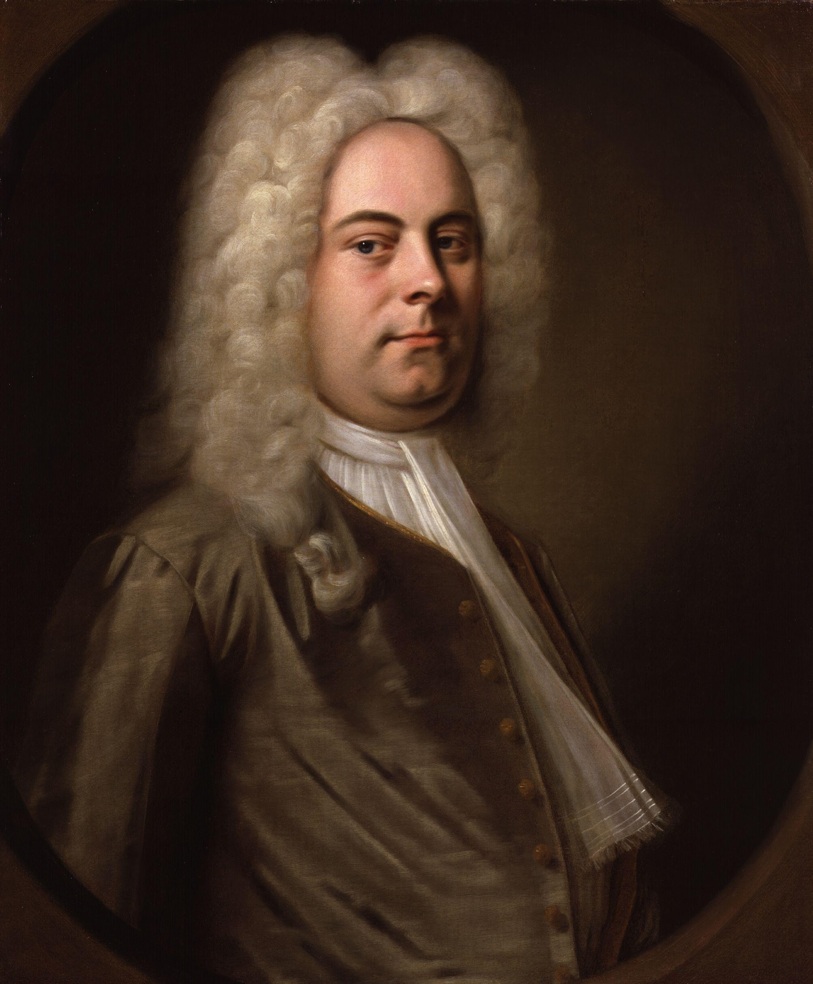
Handel’s Amadigi
The famous composer, Handel, wrote an opera based on Amadis de Gaul called Amadigi.
The opera “Amadigi” is a Chivalric Tale about a knight, a prince, a witch and a damsel in distress.
The opera’s synopsis goes like this:
"The sorceress Melissa, in love with Amadigi, has imprisoned the princess Oriana in a tower and both the knight Amadigi and the prince Dardano in her garden. After various lies, visions, and trials, the two lovers, Amadigi and Oriana, are finally united. Before then, Amadigi will kill Dardano, his companion turned rival, and Melissa will stab herself, finding her supernatural powers useless against the power of love."
Who can tell us what an opera is?
Present New Information

Slide 9
Aidan
Handel’s opera was written in 1715- a very long time ago. Music from the 1700s can feel quite old-fashioned now, and hard to understand. That’s why we’ve updated it: to Aidan, a short, modern-day video opera based on Amadigi!
Cast
Aidan: A gentle Knight, in love with Olivia
Dorian: A noble Prince, also in love with Olivia
Olivia: A beautiful Princess, in love with Aidan
Melissa: An evil Witch, also in love with Aidan
It’s nearly time to start watching, but first, label your Knight, Prince, Princess and Witch with their names: Aidan, Dorian, Olivia and Melissa.
Present New Information

Slide 10
Watch Act One of Aidan
In Act One, we meet Aidan and Dorian, who are trapped in Melissa’s magical world. She has made the whole magical place just for Aidan, who she loves. But Aidan loves Olivia, and… so does Dorian! How will they sort it all out, especially once Melissa arrives to confuse things even more?
While we’re watching, add more information to your character images, labelling them with new information about the characters from the opera (Aidan, Dorian, Melissa).
Construct Meaning

Slide 11
Character Descriptions
Using your labelled images to give you ideas, write a character description for each person we have met so far in Aidan- Aidan, Dorian and Melissa.
Try to connect them with their chivalric roles of Knight, Prince, and Witch!
Extension: Write a prediction of what you think the character of Olivia will be like, based on what you already know about princesses and damsels in distress.
Apply To Demonstrate

Slide 12
Three Questions...
What are the main character types in chivalric tales?
What are the names of the characters in Aidan?
Who is your favourite character so far?*
*(Don’t worry, there’s no right answer for this one!)
Review

